Slide 1

Plotipy Project
Stuart Yates
Pauly Richmeier
Charles Stephens

Slide 2






Tech Used

Slide 3
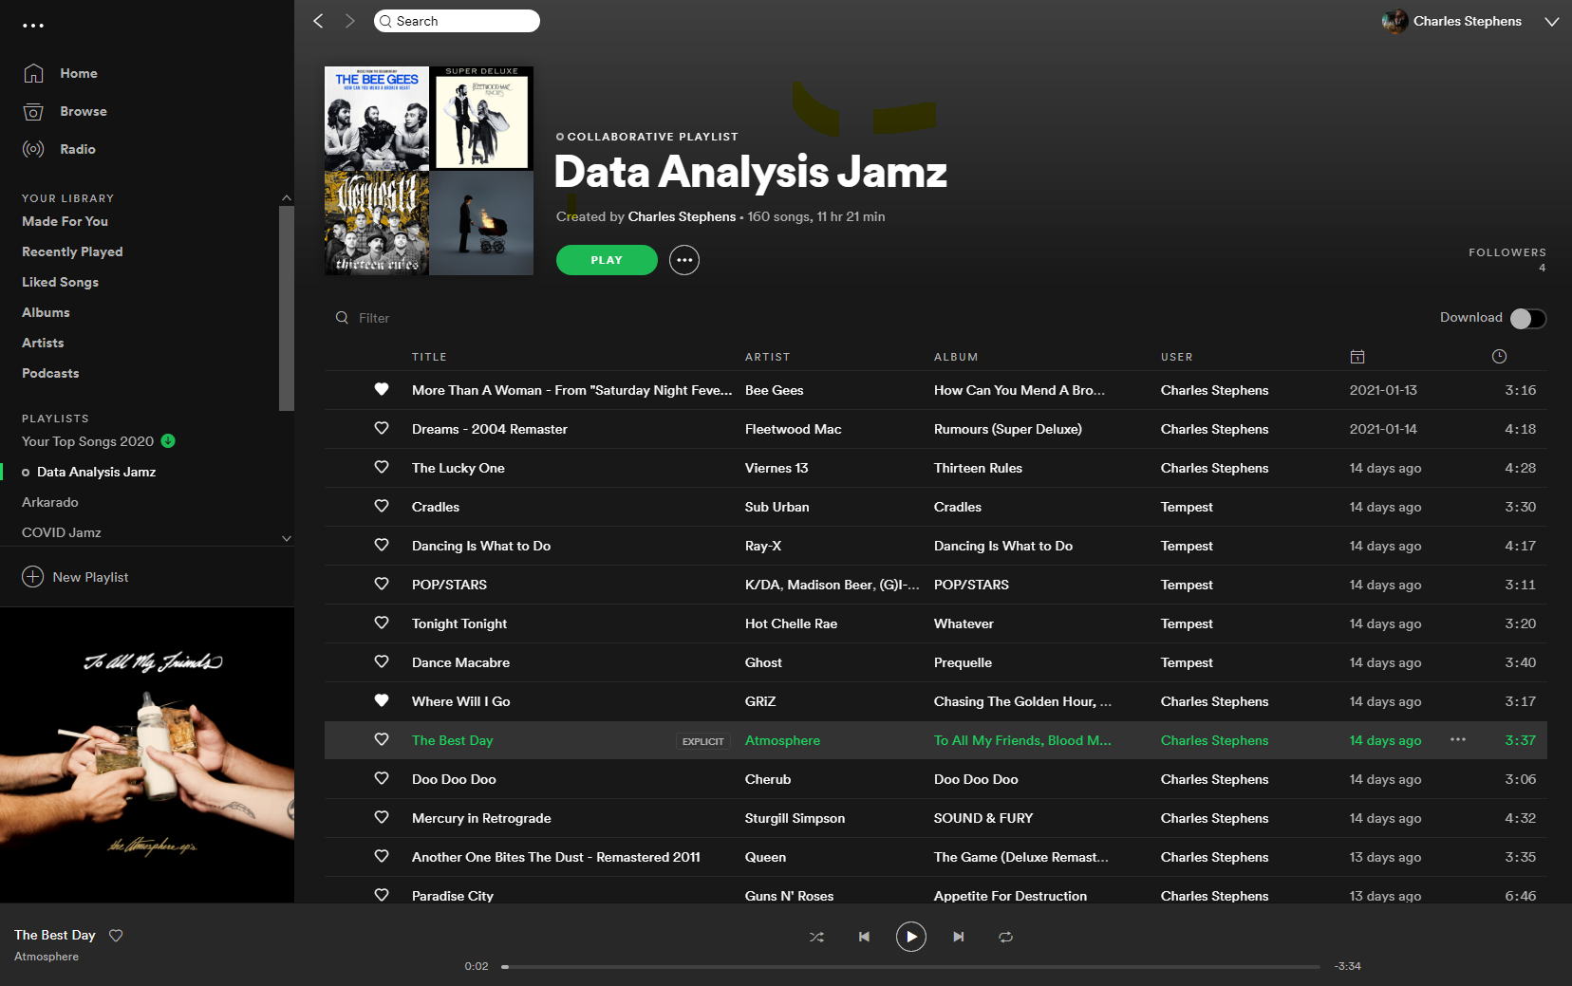
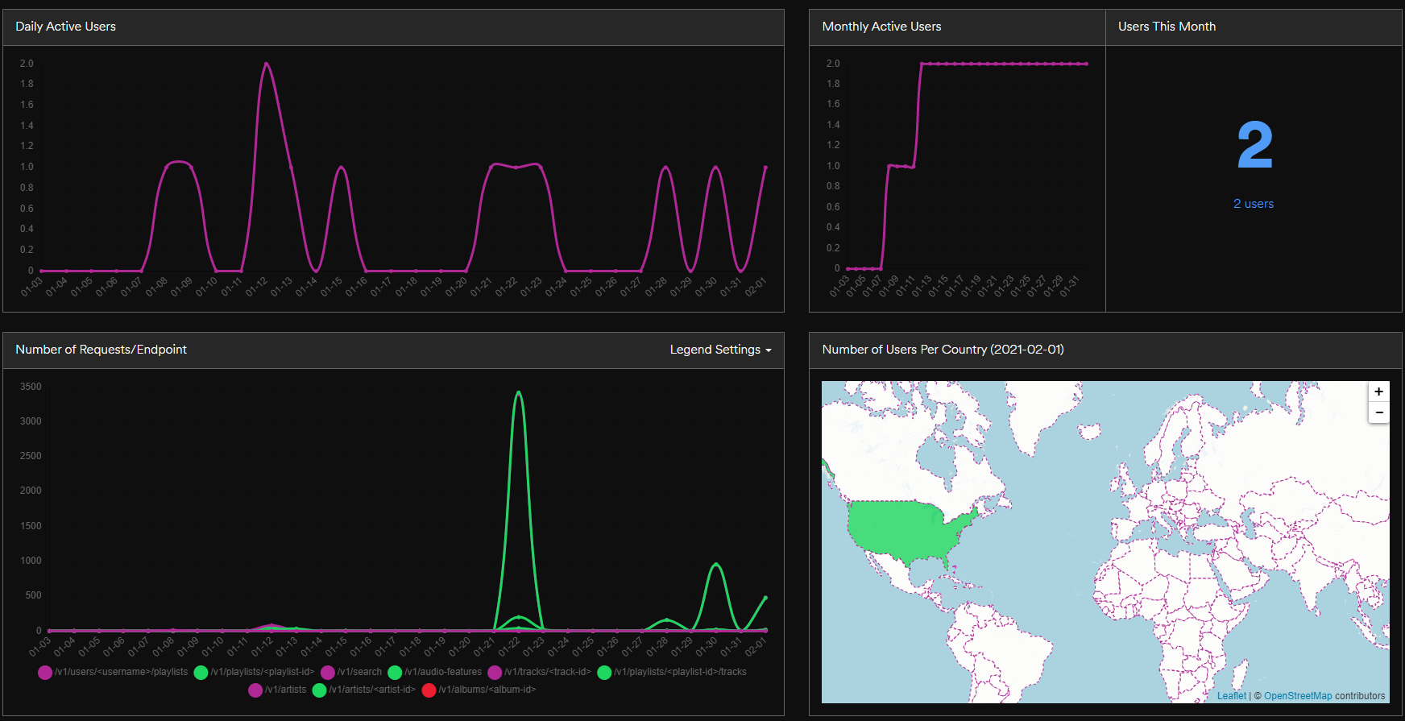
User Interface / Developer App

Slide 4
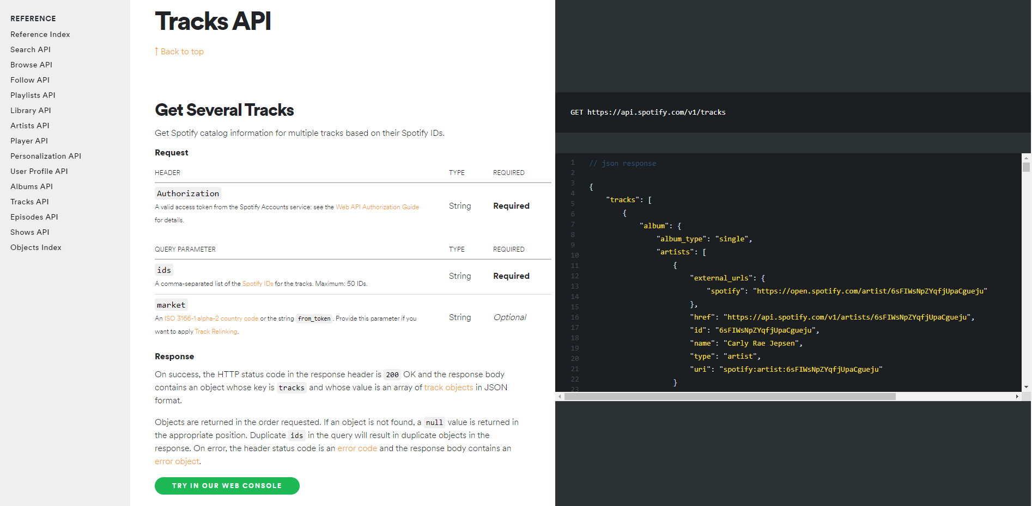
Spotify API
Data from Spotify API / Spotify Python library – SPOTIPY
pip install spotipy
https://spotipy.readthedocs.io/en/2.16.1/#
Client ID, Client Secret ID, Playlist ID, User ID, Redirect URI, Token

Slide 5
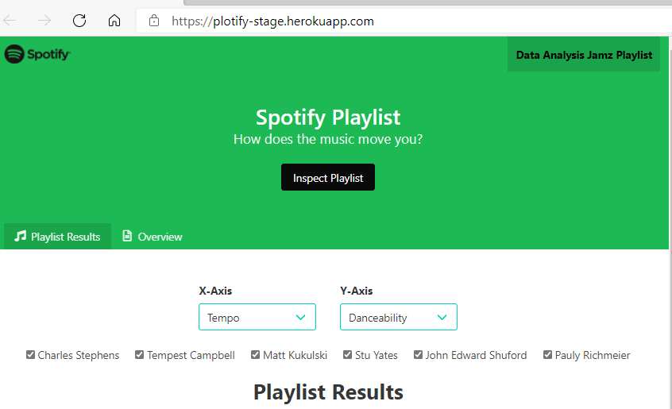
Project Website
Bulma Hero used for main page format and body
Links added for both Spotify and the playlist sights including Spotify logo
Vue code used for active tabs, dropdown menus, and checkboxes
Sass code used for site style and display
Overview page lists the comparison objects definitions

Slide 6
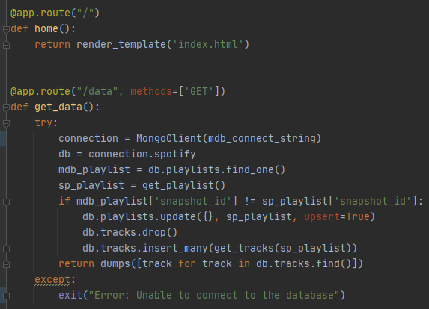
Backend Logic – Flask and PyMongo
User hits “/” route
Flask renders/returns index.html
App.js fires d3.json(“/data”)
Flask connects to MongoDB
Gets current cached playlist from playlists
Gets current playlist from Spotify API
Compares the snapshot_id
If different, makes the rest of the API calls and replaces the entire tracks collection
Returns all the tracks as JSON

Slide 7
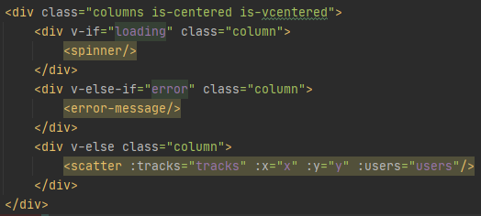
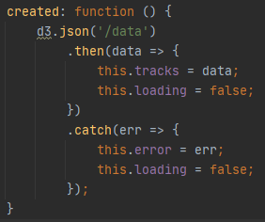

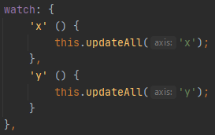
Frontend Logic – D3 and Vue
Initial state of Vue instance:
loading: true
error: null
Vue created lifecycle hook calls d3.json()
At first, user sees the loading spinner
If there is an error, user sees error message
If data returned successfully, scatter will mount
Scatter receives returned data as props
Vue mounted lifecycle hook creates circlesGroup
Selected axes have watchers that call updateAll

Slide 8
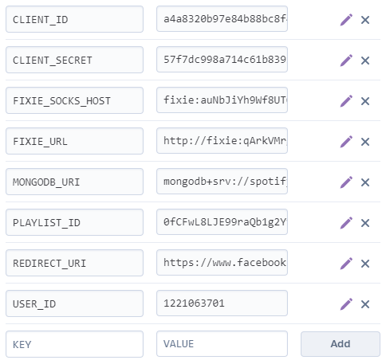
Deployment – Heroku, Pipenv and MongoDB Atlas
Pipenv for virtual environment and dependencies
Also necessary for deployment to Heroku
Local .env file for development config
Config vars in Heroku for staging/production
Staging: Replica of prod for testing
Cloud-hosted (AWS) MongoDB cluster
Fixie Socks to generate static IP for database
Need to whitelist specific IPs for Mongo
Heroku IP address is dynamic

Slide 9

Future Features
Genres by User ID
Additional Vizualizations
Suggested Concerts
Word Cloud

Slide 10

Questions ?

